Slide 1
Managing Resources

Slide 2
Objectives
After completing this lesson, you should be able to do the following:
  Configure the Database Resource Manager
  Access and create resource plans
  Create consumer groups
  Specify directives for allocating resources to consumer groups
  Map consumer groups to plans
  Activate a resource plan
  Monitor the Resource Manager

Slide 3



Database Resource Manager: Overview
Use the Resource Manager to:
  Manage mixed workload
  Control system performance
Database
Resource Manager
More resources
OLTP users
DSS users
Fewer resources
Batch users
Least resources
Oracle
database
Notes:
Database Resource Manager: Overview
By using the Database Resource Manager (also called the Resource Manager), you have more control over the allocation of machine resources than is normally possible through operating system resource management alone. If resource management decisions are made by the operating system, it can lead to problems such as:
Excessive overhead resulting from operating system context switching of Oracle database server processes when the number of server processes is high
Suspension of a database server process that is holding a latch
Unequal distribution of resources among all Oracle database processes, and an inability to prioritize one task over another
Inability to manage database-specific resources, such as parallel execution servers and active sessions
The Database Resource Manager controls the distribution of resources among various sessions by controlling the execution schedule inside the database. By controlling which sessions run and for how long, the Database Resource Manager can ensure that resource distribution matches the plan directive and, therefore, the business objectives. With the Database Resource Manager, you can guarantee groups of users a minimum amount of processing resources regardless of the load on the system and the number of users.
The DBMS_RESOURCE_MANAGER_PRIVS package contains the procedures to grant and revoke the ADMINISTER_RESOURCE_MANAGER system privilege, which is a prerequisite for invoking the Resource Manager.

Slide 4
Database Resource Manager: Concepts
Resource consumer group
User groups or sessions with similar resource needs
A blueprint for resource allocation among resource consumer groups (one active plan)
Specifies how a resource is divided among the resource consumer groups (within the scope of allocation methods)
Resource plan
Resource plan directives
Notes:
Database Resource Manager: Concepts
Administering systems by using the Database Resource Manager involves the use of resource plans, resource consumer groups, and resource plan directives.
A resource consumer group defines a set of users or sessions that have similar requirements for using system and database resources.
A resource plan specifies how the resources are distributed among various resource consumer groups. The Database Resource Manager also allows for creation of plans within plans, called subplans.
Resource plan directives specify how a particular resource is shared among consumer groups or subplans. You associate resource consumer groups and subplans with a particular resource plan through plan directives.
Resource allocation methods determine what policy to use when allocating for any particular resource. Resource allocation methods are used by resource plans and resource consumer groups.

Slide 5
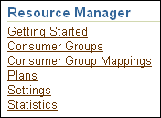
Why Use Resource Manager
  You can manage database and operating system resources, such as:
    CPU usage
    Degree of parallelism
    Number of active sessions
    Undo generation
    Operation execution time
    Idle time
    Database consolidation
    Server consolidation
  You can also specify criteria that, if met, cause the automatic switching of sessions to another consumer group.
Access via:
  EM
  DBMS_RESOURCE_MANAGER package
Notes:
Why Use Resource Manager
The Database Resource Manager provides several means of allocating resources:
CPU Method: Enables you to specify how CPU resources are allocated among consumer groups and subplans
Degree of Parallelism Limit: Enables you to control the maximum degree of parallelism for any operation within a consumer group
Active Session Pool with Queuing: Allows you to limit the number of concurrent active sessions for a consumer group or subplan. If a group exceeds the maximum allowed number of sessions, new sessions are placed in a queue where they wait for an active session to complete. You can also specify a time limit on how long a session will wait before exiting with an error.
Undo Pool: Enables you to control the total amount of undo that can be generated by a consumer group or subplan. Whenever the total undo space exceeds the amount specified by UNDO_POOL, no further INSERT, UPDATE, or DELETE commands are allowed until undo space is freed by another session in the same group or the undo pool is increased for the consumer group. If the consumer group’s quota is exceeded during the execution of a DML statement, the operation aborts and returns an error. Queries are still allowed, even if a consumer group has exceeded its undo threshold.

Slide 6
Notes:
Why Use Resource Manager (continued)
Execution Time Limit: Allows you to specify a maximum execution time allowed for an operation. The Oracle database uses cost-based optimizer statistics to estimate how long an operation will take. If it is longer than the maximum time allowed (MAX_EST_EXEC_TIME), the operation returns an error and is not started. If a resource consumer group has more than one plan directive with MAX_EST_EXEC_TIME specified, the Resource Manager chooses the most restrictive of all incoming values.
Idle Time Limit: Enables you to specify an amount of time for which a session can be idle, after which it will be terminated (MAX_IDLE_TIME). You can further restrict the Resource Manager to terminate only those sessions that are blocking other sessions (MAX_IDLE_TIME_BLOCKER).
Consumer Group Switching: The initial consumer group is the group that a session would be in had it just logged in. The top call is defined as treating an entire PL/SQL block as one call or, similarly, treating SQL statements that are issued separately by the client as separate calls. This functionality is mostly beneficial for three-tier applications where the middle-tier server implements session pooling. In this case, the middle tier tends to do one call for an end user and then use the same session for a call for a different end user. Therefore, the boundaries of work are really calls, and the actions of a prior end user should not affect the next end user. You can create a plan directive, so that the Resource Manager automatically switches the user back to the initial consumer group at the end of the top call.
Note: You cannot specify both the SWITCH_TIME_IN_CALL and SWITCH_TIME parameters within the same directive. The SWITCH_TIME parameter is primarily intended for client/server applications, whereas the SWITCH_TIME_IN_CALL parameter is for three-tier applications.
Database Consolidation: The Resource Manager enables you to optimize resource allocation among concurrent database sessions. Database consolidation requires that applications are isolated from each other. If one application experiences an increase in workload, that increase should not affect other applications. In addition, the performance of each application should be consistent. Good candidate applications for Database Consolidation are automated maintenance tasks because currently these applications can take up to 100% of the server CPU resources.
Server Consolidation: Because many test, development, and small production databases are unable to fully utilize the servers that they are on, server consolidation provides a possible alternative. With server consolidation, resources are more fully utilized by running multiple database instances on the server. The method for managing CPU allocations on a multi-CPU server with multiple database instances is called Instance Caging. Because Instance Caging is simple to configure and does not require any new software to be licensed or installed, it is an excellent alternative to other server consolidation tools, such as virtualization and O/S workload managers.
You can access resource plans with the graphical interface of Enterprise Manager or the command line of the DBMS_RESOURCE_MANAGER package.

Slide 7



Default Maintenance Resource Manager Plan
SQL> show parameter resource_manager_plan
NAME TYPE VALUE
---------------------- ------- ------------------------------------------
resource_manager_plan string SCHEDULER[0x2843]: DEFAULT_MAINTENANCE_PLAN
Notes:
Default Maintenance Resource Manager Plan
The automated maintenance tasks rely on the Resource Manager being enabled during the maintenance windows. When a maintenance window opens, the DEFAULT_MAINTENANCE_PLAN resource manager plan is automatically set to control the amount of CPU used by automated maintenance tasks. To be able to give different priorities to each possible task during a maintenance window, various consumer groups are assigned to DEFAULT_MAINTENANCE_PLAN. The hierarchy between groups and plans is shown in the slide.
For high priority tasks, see their group assignment:
Optimizer Statistics Gathering is in the ORA$AUTOTASK_STATS_GROUP consumer group.
Segment Advisor automatic is in the ORA$AUTOTASK_SPACE_GROUP consumer group.
Automatic SQL Tuning is in the ORA$AUTOTASK_SQL_GROUP consumer group.
Note: If needed, you can change the percentage of CPU resources allocated to the various automated maintenance task consumer groups inside the ORA$AUTOTASK_HIGH_SUB_PLAN.

Slide 8
Example: DEFAULT_PLAN
Resource Consumer Group | Allocation Methods
 | MGMT_P1 | MGMT_P2 | MGMT_P3
SYS_GROUP | 100% | 0% | 0%
OTHER_GROUPS | 0% | 90% | 0%
ORA$AUTOTASK_SUB_PLAN | 0% | 5% | 0%
ORA$DIAGNOSTICS | 0% | 5% | 0%
For automated
maintenance tasks
Notes:
Example: DEFAULT_PLAN
The DEFAULT_PLAN resource plan is one of the default plans provided for you. It contains directives for the following provided consumer groups:
SYS_GROUP: The initial consumer group for the SYS and SYSTEM users
OTHER_GROUPS: Used for all sessions that belong to consumer groups that are not part of the active resource plan. There must be a plan directive for OTHER_GROUPS in any active plan.
ORA$AUTOTASK_SUB_PLAN: A group with lower priority than SYS_GROUP and OTHER_GROUPS in this plan
ORA$DIAGNOSTICS: A group in this plan with the same priority as the ORA$AUTOTASK_SUB_PLAN. The low priority of the ORA$ groups prevents any automated maintenance work from consuming excessive amounts of system resources.
The initial consumer group of a user is the consumer group to which any session created by that user initially belongs. If you have not set the initial consumer group for a user, the user’s initial consumer group will automatically be DEFAULT_CONSUMER_GROUP.
The DEFAULT_PLAN and associated resource consumer groups can be used or not used. It can be a template for new resource plans; it can be modified or deleted. Use it as appropriate for your environment.

Slide 9
Potential Work Flow
Your work flow for mandatory Resource Manger objects:
  Creating a new resource plan
  Creating a consumer group
  Assigning users to groups
  Specifying resource plan directives
  Activating a resource plan
DBMS_RESOURCE_MANAGER.CREATE_CONSUMER_GROUP(
CONSUMER_GROUP => 'APPUSER',
MGMT_MTH => 'ROUND-ROBIN',
COMMENT => '');
DBMS_RESOURCE_MANAGER_PRIVS.GRANT_SWITCH_CONSUMER_GROUP (
grantee_name => 'PM',
consumer_group => 'APPUSER',
grant_option => FALSE );
Notes:
Potential Work Flow
To create a new plan, you need to configure several Resource Manager objects.
Creating a New Resource Plan
The Scheduler can automatically change the Resource Manager plan at the Scheduler window boundaries. Deselect the default Automatic Plan Switching Enabled check box if this option is unacceptable.
Creating Consumer Groups
Use the Resource Consumer Groups page in EM to create or edit a consumer group and description, to add or delete its users (members) and to define or edit its database roles.
You specify a resource allocation method for the distribution of CPU among sessions in the consumer group. “Round Robin” scheduling ensures that sessions are fairly executed. Therefore, the default allocation method is Round Robin. The “Run to Completion” allocation method specifies that sessions with the largest active time are scheduled ahead of other sessions. The equivalent functionality is achieved by the DBMS_RESOURCE_MANAGER.CREATE_CONSUMER_GROUP procedure with the MGMT_MTH option.

Slide 10
Notes:
Potential Work Flow (continued)
Assigning Users to Groups
Users should be assigned to resource consumer groups. The user’s default consumer group is the one to which any session created by that user initially belongs. If it is not set for a user, the user’s initial consumer group defaults to DEFAULT_CONSUMER_GROUP. You must directly grant to the user, or to PUBLIC, the switch privilege to a consumer group before it can be the user’s default consumer group. The switch privilege cannot come from a role granted to that user.
The DBMS_RESOURCE_MANAGER_PRIVS package contains the procedure to assign resource consumer groups to users. Granting the switch privilege to a user enables the user to switch to a different consumer group.

Slide 11
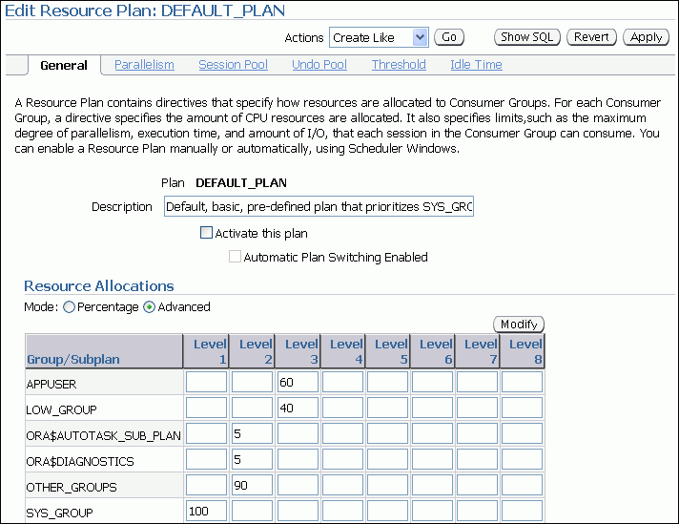
Specifying Resource Plan Directives
1
2
3
4
5
6
Notes:
Specifying Resource Plan Directives
If you do not use Enterprise Manager to create the resource plan or resource consumer groups, you must first create a pending area. This is a scratch area that enables you to stage your changes and to validate them before they are made active.
In Enterprise Manager, there are several property pages, which you can use for specifying plan directives:
1. On the General page, associate consumer groups with plans and specify how much CPU each consumer group or subplan gets with the MGMT_MTH value.
2. Specify a parallel degree limit to control the maximum degree of parallelism for any operation within a consumer group.
3. You can control the maximum number of concurrently active sessions allowed within a consumer group. An entire parallel execution session is counted as one active session.
4. You can control the amount of total undo that can be generated by a consumer group.
5. You can specify threshold values, such as execution time limit (in seconds), I/O limit (in MB), and I/O request limit (in number of requests).
6. You can specify an amount of time that a session can be idle, after which it will be terminated. You can further restrict such termination to only those sessions that are blocking other sessions.
Note: The following slides provide further details about directives using the tab numbers indicated in this slide. Refer to this slide when you see “Directive Tab n” on subsequent slides.

Slide 12
Resource Allocation Methods for Resource Plans
Parameter (Comments) | Possible Values
MGMT_MTH | EMPHASIS, RATIO
Allocating CPU usage
PARALLEL_DEGREE_LIMIT_MTH | PARALLEL_DEGREE_LIMIT_ABSOLUTE
Limiting degree of parallelism of any operation
ACTIVE_SESS_POOL_MTH | PARALLEL_DEGREE_LIMIT_ABSOLUTE
Limiting number of active sessions, queuing inactive ones
QUEUING_MTH | FIFO_TIMEOUT
Controlling queues, how inactive sessions enter active session pool
Notes:
Resource Allocation Methods for Resource Plans
Resource allocation methods determine how the Resource Manager allocates a particular resource to a resource consumer group or resource plan. You specify values for the following resource allocation methods when creating the resource plan.
There are two ways of specifying the CPU distribution with the MGMT_MTH parameter:
EMPHASIS is the default method for single-level plans. It is also used for multilevel plans that use percentages to specify how CPU is distributed among consumer groups.
RATIO is for single-level plans that use ratios to specify how CPU is distributed.
PARALLEL_DEGREE_LIMIT_MTH limits the maximum degree of parallelism of any operation. This method can be specified only for resource consumer groups, not subplans. The PARALLEL_DEGREE_LIMIT_ABSOLUTE method is the only possible value, specifying how many processes may be assigned to an operation. If there are multiple plan directives referring to the same subplan or consumer group, the minimum of all the possible values is used as the parallel degree limit for that subplan or consumer group.
The ACTIVE_SESS_POOL_MTH parameter limits the number of active sessions. All other sessions are inactive and wait in a queue to be activated. The only value (that is, the only available method) for this parameter is PARALLEL_DEGREE_LIMIT_ABSOLUTE, which is its default value.
QUEUING_MTH controls the order in which queued inactive sessions execute. FIFO_TIMEOUT is the default and only method available.

Slide 13
Comparison of EMPHASIS and RATIO
EMPHASIS | RATIO
The value specifies the maximum percentage of CPU resources a consumer group can use. | The value specifies a number that indicates the ratio of CPU resources to be allocated to the consumer group.
You can allocate resources for up to 8 different levels. | You can specify values for only one level.
The sum of percentages at any given level must be less than or equal to 100. | You must use integer values, but there is no limit on the sum of values.
Default value is NULL. | Default value is NULL.
Notes:
Comparison of EMPHASIS and RATIO
The CPU allocation method EMPHASIS determines how much emphasis is given to sessions in different consumer groups in a resource plan. CPU usage is assigned levels from 1 through 8, with Level 1 having the highest priority. Percentages specify how to allocate CPU to each consumer group at each level.
The following rules apply for the EMPHASIS resource allocation method:
CPU resources are distributed at a given level on the basis of the specified percentages. The percentage of CPU specified for a resource consumer group is a maximum for how much that consumer group can use at a given level.
Consumer resources that are not used at a given level are made available to consumer groups at the next level. For example, if the consumer groups at Level 1 use only 60% of the available resources, the additional 40% is made available to consumer groups at
Level 2.
The sum of percentages at any given level must be less than or equal to 100.
Any levels that have no plan directives explicitly specified have a default of 0% for all subplans or consumer groups.
The EMPHASIS resource allocation method avoids starvation problems, where consumers with lower priorities are not given the opportunity to run.

Slide 14
Notes:
Comparison of EMPHASIS and RATIO (continued)
The RATIO policy is a single-level CPU allocation method. Instead of percentages, you specify numbers corresponding to the ratio of CPU you want to give to the consumer group. For example, given three consumer groups OLTP_USERS, DSS_USERS, and BATCH_USERS, you can specify the following ratios:
OLTP_USERS: 4
DSS_USERS: 3
BATCH_USERS: 2
OTHER: 1
This is similar to saying that OLTP users should get 40% of the resources, DSS users should get 30% of the resources, BATCH users should get 20% of the resources, and all other consumer groups should get 10% of the available resources.
If there are no consumers in the OTHER or DSS_USERS consumer groups currently utilizing CPU resources, then the OLTP_USERS consumer group would get two-thirds of the available resources and the BATCH_USERS consumer group would get the other third.

Slide 15
Active Session Pool Mechanism
OLTP users
Active_sess_pool_P1=5
DSS users
Active_sess_pool_P1=3
Sess4
Sess5
p001
p002
p003
DSS
active
session
queue
Sess10
Sess3
Sess8
Sess9
Sess1
Sess2
Sess6
Sess7
Notes:
Oracle Database 11g: Administration Workshop II 16 - <number>
Active Session Pool Mechanism
Using the Active Session Pool feature, you can control the maximum number of concurrently active sessions per resource consumer group. With this functionality, a DBA can indirectly control the amount of resources that any resource consumer group uses because resource consumption is proportional to the number of active sessions. Using an active session pool can help to reduce the number of servers taking resources in the system, thus avoiding inefficient paging, swapping, and other resource depletion (such as memory) resulting from attempting to run too many jobs simultaneously.
After the Active Session Pool is filled with active sessions, the Resource Manager queues all subsequent sessions attempting to become active until other active sessions complete or become inactive. An active session is one currently involved in a transaction, query, or parallel operation. Individual parallel slaves are not counted as sessions; the entire parallel operation counts as one active session.
There is only one queue per resource consumer group and the queuing method is first in, first out (FIFO) with a timeout. The queue is implemented as a memory structure and cannot be queried directly.

Slide 16
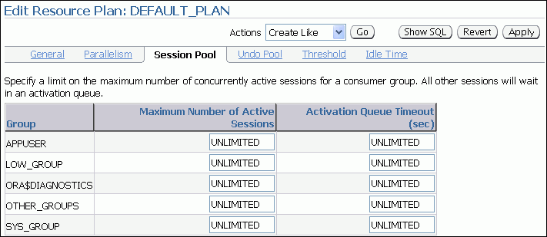
Setting the Active Session Pool
50
Notes:
Oracle Database 11g: Administration Workshop II 16 - <number>
Setting the Active Session Pool
You can easily configure the Active Session Pool settings for a resource plan by using Enterprise Manager.
Example, if you limit the Maximum Number of Active Sessions to 50 for the APPUSER consumer group:
BEGIN
dbms_resource_manager.clear_pending_area();
dbms_resource_manager.create_pending_area();
dbms_resource_manager.update_plan_directive(
plan => 'DEFAULT_PLAN',
group_or_subplan => 'APPUSER',
new_comment => '',
new_active_sess_pool_p1 => 50,
new_queueing_p1 => NULL,
new_parallel_degree_limit_p1 => NULL,
new_switch_group => '',
new_switch_time => NULL,
new_switch_estimate => false,

Slide 17
Notes:
Setting the Active Session Pool (continued)
new_max_est_exec_time => NULL,
new_undo_pool => NULL,
new_max_idle_time => NULL,
new_max_idle_blocker_time => NULL,
mgmt_p1 => NULL,
mgmt_p2 => NULL,
mgmt_p3 => 60,
mgmt_p4 => NULL,
mgmt_p5 => NULL,
mgmt_p6 => NULL,
mgmt_p7 => NULL,
mgmt_p8 => NULL,
switch_io_megabytes => NULL,
switch_io_reqs => NULL,
switch_for call);
dbms_resource_manager.submit_pending_area();
END;

Slide 18
Specifying Thresholds
Specifying execution time limit:
  Proactive estimation of the execution time for an operation (via cost-based optimizer statistics), default: UNLIMITED
  Specifying maximum estimated execution time at the resource consumer group level
  No start allowance for huge jobs, if the estimate is longer than MAX_EST_EXEC_TIME:(ORA-07455)
Specifying other thresholds:
  Limiting session I/O with SWITCH_IO_MEGABYTES (in MB)
  Limiting session I/O requests with SWITCH_IO_REQS
Returning to original consumer group with SWITCH_FOR_CALL (Default: FALSE, consumer group is not restored)
Notes:
Oracle Database 11g: Administration Workshop II 16 - <number>
Specifying Threshold
You can define the maximum estimated execution time any operation can take at any given time by setting the resource plan directive’s MAX_EST_EXEC_TIME parameter.
When this parameter is set, the Database Resource Manager estimates the time a specific job will take, which is calculated using the statistics from the cost-based optimizer.
If a resource consumer group has more than one plan directive referring to it, it may have more than one MAX_EST_EXEC_TIME. The Database Resource Manager then chooses the most restrictive of all incoming values.
If the operation’s estimate is more than MAX_EST_EXEC_TIME, then the operation does not start and the ORA-07455 error is issued. This eliminates any exceptionally large jobs that would utilize too many system resources.
The SWITCH_IO_MEGABYTES directive specifies the amount of I/O (in MB) that a session can issue before an action is taken. The default is NULL, which means unlimited.
The SWITCH_IO_REQS directive specifies the number of I/O requests that a session can issue before an action is taken. The default is NULL, which means unlimited.
The SWITCH_FOR_CALL directive specifies that if an action is taken because of the SWITCH_TIME, SWITCH_IO_MEGABYTES, or SWITCH_IO_REQS parameters, the consumer group is restored to its original consumer group at the end of the top call. Default is FALSE, which means that the original consumer group is not restored at the end of the top call.

Slide 19
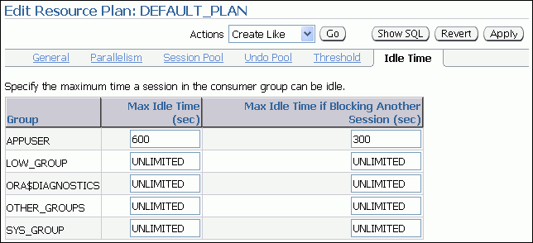
Setting Idle Timeouts
DBMS_RESOURCE_MANAGER.UPDATE_PLAN_DIRECTIVE
(PLAN => 'DAY_PLAN',
GROUP_OR_SUBPLAN => 'APPUSER',
COMMENT => 'Limit Idle Time Example',
NEW_MAX_IDLE_TIME => 600,
NEW_MAX_IDLE_BLOCKER_TIME => 300);
Notes:
Oracle Database 11g: Administration Workshop II 16 - <number>
Setting Idle Timeouts
You use the resource plan’s Idle Time tab to set the maximum idle timeouts for a resource plan. “Max Idle Time (sec)” and “Max Idle Time if Blocking Another Session (sec)” are the respective equivalents of the NEW_MAX_IDLE_TIME and NEW_ MAX_IDLE_BLOCKER_TIME resource directives in the DBMS_RESOURCE_MANAGER.UPDATE_PLAN_DIRECTIVE procedure. They are both specified in seconds.
NEW_MAX_IDLE_TIME specifies the time that a session is neither executing nor waiting for I/O. When the session exceeds the specified limit, the PMON process forcibly kills the session and cleans up its state. In addition to limiting the maximum idle time for a session, you can also limit the amount of time that an idle session can block another session. You impose this limit by setting the NEW_MAX_IDLE_BLOCKER_TIME resource directive to the number of seconds to allow a session to be idle while blocking another session. You can also specify a value of UNLIMITED to indicate that no maximum time has been set. The default is NULL, which means unlimited. These settings give you a more granular control than profiles, whose single value cannot distinguish between blocking and nonblocking sessions.
In the slide example, the PMON process kills sessions that are idle for longer than 600 seconds. The PMON process also kills sessions that are idle for more than 300 seconds and are blocking other sessions. PMON checks these limits once every minute and if it finds a session that has exceeded one of the limits, it forcibly kills the session and cleans up all its resources.

Slide 20
Limiting CPU Utilization at the Database Level
Database consolidation requirements:
  Applications isolated from each other
  Consistent performance
CPU directives can be used to:
  Specify a minimum CPU allocation for each application
  Designate how unused allocations should be redistributed
  Specify the MAX_UTILIZATION_LIMIT attribute to impose an absolute upper limit on CPU utilization (which overrides any redistribution of CPU within a plan)
  Good candidate: Auto-maintenance tasks
Notes:
Oracle Database 11g: Administration Workshop II 16 - <number>
Limiting CPU Utilization at the Database Level
For concurrent database sessions: Database consolidation requires that applications are isolated from each other. If one application experiences an increase in workload, that increase should not affect other applications. In addition, the performance of each application should be consistent.
Fixed Policy CPU Resource Management
The MAX_UTILIZATION_LIMIT attribute of resource plan directives enables you to impose an absolute upper limit on CPU utilization for a resource consumer group. This absolute limit overrides any redistribution of CPU within a plan.
Note: Good candidate applications for database consolidation are automated maintenance tasks because currently these applications can take up to 100% of the server CPU resources. You can set a maximum limit for each auto-task consumer group.

Slide 21
Limiting CPU Utilization at the Database Level
Specify minimum and maximum CPU utilization limits.
Specify maximum CPU utilization limits only.
DB Consolidation Plan #1
DB Consolidation Plan #2
CPU Maximum
Allocation Utilization Limit
App 1 50% 60%
App 2 20% 30%
App 3 20% 30%
App 4 10% 20%
CPU Maximum
Allocation Utilization Limit
App 1 null 50%
App 2 null 20%
App 3 null 20%
App 4 null 10%
EXEC DBMS_RESOURCE_MANAGER.CREATE_PLAN_DIRECTIVE( -
plan => 'db_consolidation_plan',
group_or_subplan => 'App_1',
mgmt_p1 => 50,
max_utilization_limit => 60);
Notes:
Limiting CPU Utilization at the Database Level (continued)
The MAX_UTILIZATION_LIMIT directive limits the CPU consumption of an application. You can set minimum and maximum boundaries, as shown in the slide.
The PL/SQL example in the slide specifies a minimum value percentage (50%) for the CPU allocation resource at level 1 for the APP_1 consumer group. This example also specifies an absolute maximum CPU utilization percentage (60%) permitted for that same consumer group. The example uses the DB_CONSOLIDATION_PLAN plan.
Similar commands can be executed for each consumer group shown in the sample tables.
Note: In releases prior to Oracle Database 11gR2, the implicit maximum utilization limit was set to 100%.

Slide 22
Limiting CPU Utilization at the Server Level:
Instance Caging
  Managing CPU allocations on a multi-CPU server with multiple database instances
  Enabling instance caging :
    Enable any CPU resource plan.
    Specify the maximum number of CPUs that the instance can use at any time.
Two approaches:
    Over-provisioning: The sum of the CPU limit for each instance exceeds the actual number of CPUs.
    Partitioning: The sum of the CPU limit for each instance equals the actual number of CPUs.
alter system set resource_manager_plan = 'default_plan';
alter system set cpu_count=4;
Notes:
Oracle Database 11g: Administration Workshop II 16 - <number>
Limiting CPU Utilization at the Server Level: Instance Caging
Because many test, development, and small production databases are unable to fully utilize the servers that they are on, server consolidation provides a possible alternative. With server consolidation, resources are more fully utilized by running multiple database instances on the server. However, this may bring about CPU contention and an adverse impact due to workload surges on one instance.
Instance caging is a method that uses the CPU_COUNT initialization parameter to limit the number of CPUs that an instance can use. In addition, the Resource Manager is employed to allocate the CPUs for the database sessions based on the instance resource plan.
Configure instance caging in two steps, by enabling:
The Resource Manager, which limits the amount of CPU that the database instance consumes
The CPU_COUNT parameter, which specifies the maximum (the limit), not actual amount of CPU that the database instance can use at any time
By default, the CPU Resource Manager assumes that the database instance can use all CPUs on a server. To enable instance caging, any resource plan with CPU directives can be used.

Slide 23
Instance Caging Examples
Over-provisioning approach:
One database instance
can still impact the others.
Partitioning approach:
One database instance
cannot impact the others.
Sum of CPU_COUNTS settings = 32
Sum of CPU_COUNTS = 16
32
16
Total number
of CPUs = 16
Instance D
Instance D
24
12
Instance C
Instance C
Instance B
16
Total number
of CPUs = 16
8
Instance B
Instance A
8
4
Instance A
With all four instances active,
one instance can get
4 / (4 + 4 + 4 + 4) = 25% of CPU.
Each instance has a
dedicated number of CPUs.
Notes:
Instance Caging Examples
Over-provisioning approach: This approach is appropriate for noncritical databases and low-load, noncritical production systems. Although the instances impact each other’s performance, at any given time, one or more of the instances may be idle or experiencing a low load.
Although the database instances can impact each other’s performance, instance caging limits their impact and helps to provide predictable performance. In the left example, where all four instances have CPU_COUNT set to 4, the maximum percentage of CPU that a database instance can consume at any point in time is its own limit divided by the sum of the limits for all active databases. In this example, one instance will be able to consume 4 / (4 + 4 + 4 + 4) = 25% of the CPU. If only two instances are active, one instance will be able to consume 4 / (4 + 4) = 50% of the CPU.
Partitioning approach: This approach is appropriate for critical product systems. It prevents the instances from interfering with each other and provides predictable performance.
Instance caging can partition the CPU resources by ensuring that the sum of all CPU limits does not exceed the total number of CPUs. In the example on the right, if four database instances share a 16-CPU server, their limits can be set to 8, 4, 2, and 2. By dedicating CPU resources to a database instance, partitioning provides two advantages:
One database instance’s CPU load cannot affect another’s.
Each database instance’s CPU resources is fixed, leading to more predictable performance.

Slide 24
Monitoring Instance Caging
View value of the CPU_COUNT parameter:
SELECT value FROM v$parameter WHERE name = 'cpu_count' AND (isdefault = 'FALSE' OR ismodified != 'FALSE');
Determine the Resource Manager status:
SELECT name FROM v$rsrc_plan
WHERE is_top_plan = 'TRUE' AND cpu_managed = 'ON';
Manage throttling:
SELECT begin_time, consumer_group_name, cpu_consumed_time, cpu_wait_time
FROM v$rsrcmgrmetric_history
ORDER BY begin_time;
SELECT name, consumed_cpu_time, cpu_wait_time
FROM v$rsrc_consumer_group;
Notes:
Monitoring Instance Caging
If the CPU_COUNT parameter is not set, no value is returned by the first query.
If no rows are returned by the second query in the slide, the Resource Manager is not managing the CPU. If a row is returned, it indicates the active plan.
Instance caging limits the CPU consumption of the foreground processes by throttling them. A foreground process is throttled when it is waiting on the “resmgr:cpu quantum” wait event.
You can monitor the amount of throttling in two ways:
The V$RSRCMGRMETRIC_HISTORY view shows the amount of CPU consumption (CPU_CONSUMED_TIME) and throttling (CPU_WAIT_TIME) for each minute in the past hour. Values are displayed in milliseconds.
The V$RSRC_CONSUMER_GROUP view shows the amount of CPU consumption (CPU_CONSUMED_TIME) and throttling (CPU_WAIT_TIME) since CPU Resource Management was enabled. The time is displayed in milliseconds.
Note: For case studies, see the Oracle White Paper titled Database Instance Caging: A Simple Approach to Server Consolidation.

Slide 25
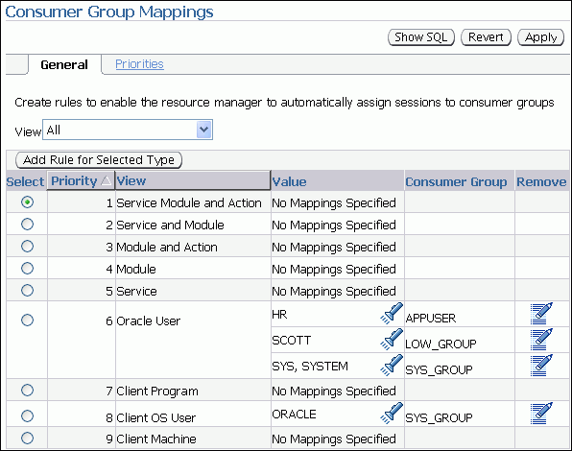
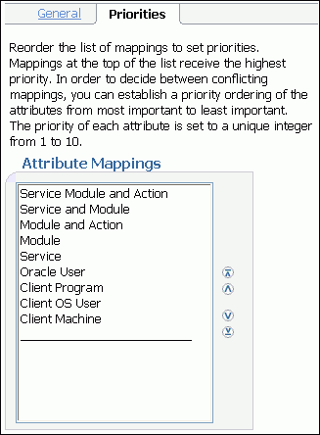
Resource Consumer Group Mapping
Notes:
Oracle Database 11g: Administration Workshop II 16 - <number>
Resource Consumer Group Mapping
You can configure the Database Resource Manager to automatically assign consumer groups to sessions by providing mappings between session attributes and consumer groups. Further, you can prioritize the mappings so as to indicate which mapping has precedence in case of conflicts. There are two types of session attributes: login attributes and run-time attributes. The login attributes (the last five in the Attribute Mappings list shown in the slide) are meaningful only at session login time, when the Database Resource Manager determines the initial consumer group of the session. In contrast, a session that has already logged in can later be reassigned to another consumer group on the basis of its run-time attributes.
From the Database Control home page, navigate to the Server tabbed page, and then click the Resource Consumer Group Mappings link in the Resource Manager section. For each of the attributes, set up a mapping that consists of a way to identify a session (for example, username), and a consumer group. Add or remove rows for each of the resource consumer group categories, as required, and enter text identifying the user, client, module, or service in the corresponding group. You can establish a priority ordering between conflicting mappings of the attributes by using the Priorities tab. You can set the priority from the most important to the least important by using the navigational arrows (as highlighted). The mappings at the top of the list have the highest priority.
Using EM Database Control, you can easily view the SQL generated from your actions by clicking the Show SQL button.

Slide 26
Notes
Notes:
Resource Consumer Group Mapping (continued)
Example to give the Client OS User a higher priority than the Client Program:
BEGIN
dbms_resource_manager.clear_pending_area();
dbms_resource_manager.create_pending_area();
dbms_resource_manager.set_consumer_group_mapping(
dbms_resource_manager.oracle_user,
'SCOTT',
'LOW_GROUP'
);
dbms_resource_manager.set_consumer_group_mapping_pri(
EXPLICIT => 1, SERVICE_MODULE_ACTION => 2,
SERVICE_MODULE => 3,
MODULE_NAME_ACTION => 4,
MODULE_NAME => 5,
SERVICE_NAME => 6,
ORACLE_USER => 7,
CLIENT_OS_USER => 8,
CLIENT_PROGRAM => 9,
CLIENT_MACHINE => 10
);
dbms_resource_manager.submit_pending_area();
END;

Slide 27
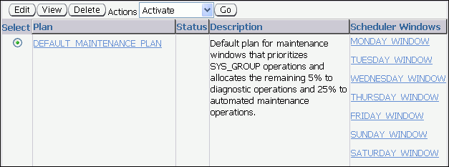
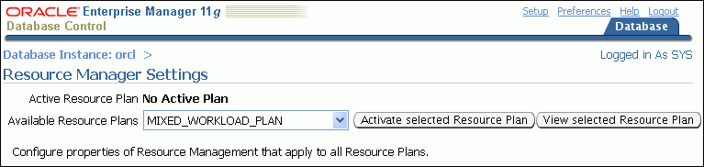
Activating a Resource Plan
EM > Server > Settings (in the Resource Manager section)
Notes:
Activating a Resource Plan
You can use the Plans page of Enterprise Manager to manage resource plans. To activate a plan, select the plan you want to make active, choose Activate from the Actions drop-down list, and then click Go. The plan you selected is then made the current top plan for the instance.
Using the RESOURCE_MANAGER_PLAN Initialization Parameter
The plan for an instance is defined using the RESOURCE_MANAGER_PLAN database initialization parameter. This parameter specifies the top plan to be used for this instance. If no plan is specified, the Resource Manager is not activated for the instance.
You can activate, deactivate, or change the current top plan by using an ALTER SYSTEM statement. When a resource plan is changed using this command, the change takes effect instantly.
If the parameter is set in a parameter file, and the plan specified is not defined in the database, then the database cannot be opened with that parameter file. The following error is returned:
ORA-07452: specified resource manager plan does not exist in the data dictionary
If this error is encountered, the parameter must be modified to show a correct value before the instance can be restarted.

Slide 28
Database Resource Manager Information
View Name | Information
DBA_RSRC_PLANS | Plans and status
DBA_RSRC_PLAN_DIRECTIVES | Plan directives
DBA_RSRC_CONSUMER_GROUPS | Consumer groups
DBA_RSRC_CONSUMER_GROUP_PRIVS | Users/roles
DBA_RSRC_GROUP_MAPPINGS | Consumer group mapping
DBA_RSRC_MAPPING_PRIORITY | Mapping priority
DBA_USERS | Column initial_rsrc_consumer_group
DBA_RSRC_MANAGER_SYSTEM_PRIVS | Users/roles
Notes:
Database Resource Manager Information
Several data dictionary views are available to check the resource plans, consumer groups, and plan directives that are declared in the instance. This section discusses some useful information that can be obtained from these views. For more detailed information about the contents of each of these views, refer to the Oracle Database Reference manual.
Use the following query to obtain information about resource plans defined in the database:
SQL> SELECT plan, num_plan_directives, status, mandatory
2 FROM dba_rsrc_plans;
PLAN NUM_PLAN_DIRECTIVES STATUS MAN
-------------- ------------------- --------- ---
DEFAULT_PLAN 3 ACTIVE NO
INTERNAL_QUIESCE 2 ACTIVE YES
INTERNAL_PLAN 1 ACTIVE YES
BUGDB_PLAN 4 ACTIVE NO
MAILDB_PLAN 3 ACTIVE NO
MYDB_PLAN 3 ACTIVE NO
A status of ACTIVE indicates that the plan has been submitted and can be used, whereas a status of PENDING shows that the plan has been created, but is still in the pending area.
If the mandatory column is assigned a value of YES, then the plan cannot be deleted.

Slide 29
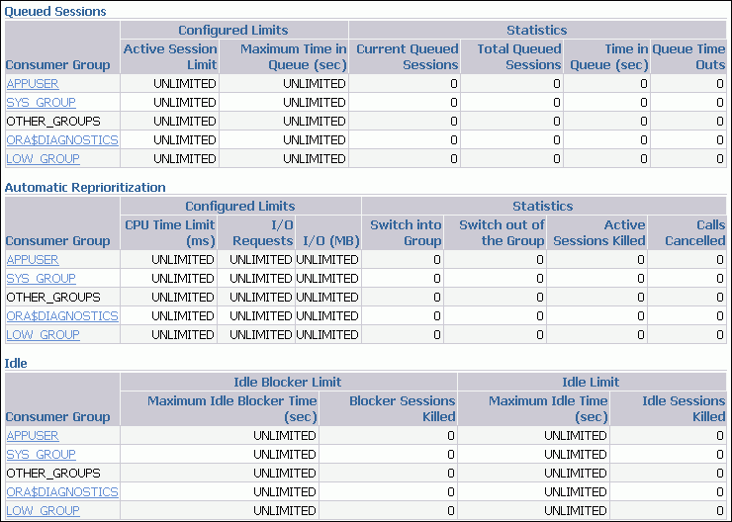
Monitoring the Resource Manager
Notes:
Monitoring the Resource Manager
You can monitor the functioning of the Database Resource Manager at the session level. It is integrated with Automatic Database Diagnostic Monitor (ADDM).
There are different ways to manage and monitor the Resource Manager by using EM Database Control. On the Server tabbed page, click the Statistics link in the Resource Manager section.
The Resource Manager Statistics page displays a grouping of statistics and charts that depict the current state of the active resource plan. You can view the statistics for the currently active plan.
For Resource Usage, you can view “CPU Consumed,” “I/O Requests per Second,” and “Megabytes of I/O Issued per Second.” Another chart displays “Resource Manager Induced Waits.” Then there are statistics for “Queued Sessions,” “Automatic Reprioritization,” and idle time.

Slide 30
Monitoring the Resource Manager
  V$SESSION: Contains the resource_consumer_group column that shows the current group for a session
  V$RSRC_PLAN: A view that shows the active resource plan
  V$RSRC_CONSUMER_GROUP: A view that contains statistics for all active groups
Notes:
Monitoring the Resource Manager (continued)
CPU Utilization
There are at least three different views in the system that can provide you with information about the CPU utilization inside the Oracle database:
V$RSRC_CONSUMER_GROUP shows CPU utilization statistics on a per consumer group basis, if you are running the Oracle Database Resource Manager. This view displays data related to currently active resource consumer groups.
V$SYSSTAT shows the Oracle database CPU usage for all sessions. The statistic “CPU used by this session” shows the aggregate CPU used by all sessions.
V$SESSTAT shows the Oracle database CPU usage per session. You can use this view to determine which particular session is using the most CPU.
The V$RSRC_CONSUMER_GROUP View
The following is a quick description of some of the columns in this view:
name: Name of the consumer group
active_sessions: Number of currently active sessions in this consumer group
execution_waiters: Number of active sessions waiting for a time slice
requests: Cumulative number of requests executed in this consumer group
cpu_wait_time: Cumulative amount of time that sessions waited for CPU
consumed_cpu_time: Cumulative amount of CPU time consumed by all sessions

Slide 31
Notes:
Monitoring the Resource Manager (continued)
There is no view that shows the Active Session Pool queue directly, but you can get some information from:
V$SESSION: The current_queue_duration column shows how long a session has been queued, or 0 (zero) if the session is not currently queued.
V$RSRC_CONSUMER_GROUP: The queue_length column shows the number of sessions currently queued per consumer group.

Slide 32
Quiz
Select the statements that are true about the Resource Manager and its functionality:
  You can set threshold values only for execution time, not for session I/O.
  You can limit CPU utilization at the database level to isolate applications for each other.
  On a multi-CPU server with multiples database instances, you can limit each server’s CPU utilization by enabling instance caging.
  When the SWITCH_TIME, SWITCH_IO_MEGABYTES, or SWITCH_IO_REQS parameters cause a switch in consumer groups, you can never return to the original consumer groups.
Notes:
Answer: 2, 3

Slide 33
Summary
In this lesson, you should have learned how to do the following:
  Configure the Database Resource Manager
  Access and create resource plans
  Create consumer groups
  Specify directives for allocating resources to consumer groups
  Map consumer groups to plans
  Activate a resource plan
  Monitor the Resource Manager

Slide 34
Practice 16 Overview:
Using the Resource Manager
This practice covers the following topics:
  Creating a resource consumer group
  Specifying CPU resource allocation directives for consumer groups
  Associating users with a resource consumer group
  Activating a resource plan
  Testing in SQL*Plus
  Deactivating a resource plan
Notes:
Oracle Database 11g: Administration Workshop II 16 - <number>

